Slide 1



Context-Aware Implicit Feedback based Hotel Recommender System for Anonymous Business Travellers
Molood Arman
Supervisor: Nacera Bennacer
Advisors: Srudeep Katamreddy
Christophe Blaya
Confidential Thesis
2018

Slide 2
01. Introduction
Agenda.
02. Literature Review
03. Preprocessing & Analysis Data
04. Solution
05. Evaluation
06. Conclusion & Future works
06. Q & A

Slide 3










Problem Statement
Introduction
Literature
Review
Contracts
Data
preprocessing
Contracts
Solution
Evaluation
Conclusion
Items
Users
Booking data is gathering
From different travel agencies

Slide 4

Objectives
Introduction
Extract business policy of each Company
from historical data
Literature
Review
01
Data
preprocessing
02
Developing a model based recommender system (RS) based on historical data
Solution
Evaluation
03
Improving RS performance by embedding
profiles created just based on historical data
Conclusion
04
Considering context to give more accurate recommendations to each customer.

Slide 5
Evolution Of RS
Introduction
Item Hierarchy
If you buy printer, you will need ink
-BestBuy
Attribute-based RS
You like action movies starring Clint Eastwood, then you probably like “good, bad and the ugly”
-Netflix
Collaborative Filtering
(item-item similarity)
You like Godfather, then you will like Scarface
-Netflix
Model based
training SVM, LDA, SVD, NN and etc. for implicit features
Collaborative Filtering
(user-user similarity)
People like you, who bought beer, also bought diapers.
-Target
Literature
Review
Data
preprocessing
Solution
Evaluation
Conclusion
Top N-Recommendations
Memory based
Notes:
User-based CF is said to be "memory-based"
the rating matrix is directly used to find neighbors / make predictions
does not scale for most real-world scenarios
large e-commerce sites have tens of millions of customers and millions of items

Slide 6
Challenges
Introduction
Literature
Review
Data
preprocessing
Sparsity
Cold Start
Solution
There is no access to
enough information
There are not any current
available data for new items/users
Evaluation
Conclusion
Scalability
Over Specialization
Capacity to deal with
growing amount of data.
Users are limited to getting recommendations which definitely known or defined in
their profiles
 | Companies | Hotels | Density
Data | 38,308 | 94,074 | 0.025%
Notes:
The main reason behind data sparsity is that most users do not rate or use most of the items and the current ratings are usually sparse

Slide 7
Context Aware RS
Introduction
Literature
Review
Contextual Pre Filtering
2D recommender system
The current context is used for just selecting only the relevant set of data
Contextual Post Filtering
2D recommender system
The resulting set of recommendations is adjusted for each user using the contextual information
Contextual Modeling
MD recommender system
contextual information is used directly inside the model as part of the rating estimation
Data
preprocessing
Solution
Evaluation
Conclusion
Notes:
The main reason behind data sparsity is that most users do not rate or use most of the items and the current ratings are usually sparse

Slide 8



Data Acquisition
Introduction
Literature
Review
Data
preprocessing
01
Explicit Data
customer rating or
feedbacks
Solution
Evaluation
02
Implicit Data
Purchase History
Conclusion
03
Side Information
product Attributes or Product Descriptions

Slide 9
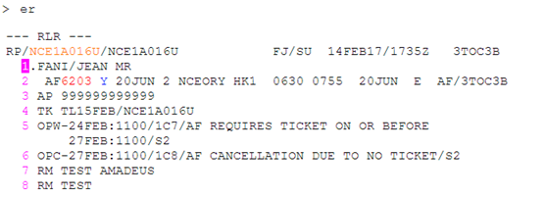
Data Acquisition
Introduction
Literature
Review
Data
preprocessing
Solution
Evaluation
Conclusion
Passenger Name Record (PNR)
Notes:
is a record which stores the booking information.
The reservation stored can belong to multiple passengers, as long as they all
have the same itinerary. The information contained by a PNR includes the following
items but is not limited to them: Passenger information (Name, email addresses,
Contact information and etc), Segments (origin, destination, flight ID, departure
and arrival date), Services (additional luggages, seat, special meal, booking cars and
hotels), Travel agency information (Office Id) and etc. one example of PNR is shown

Slide 10

Preprocessing & Analysis Data
Introduction
Literature
Review
Data
preprocessing
Solution
Raw Data
Name
Companies
Preprocessing
Data
Evaluation
Conclusion
Duplication
Transforming
Data
Missing Value

Slide 11
 | Type | Distinct Value | Missing Value
Date | String | 2405659 | 0
PropertyId | String | 94314 | 0
ChainCode | String | 319 | 0
RateCode | String | 11455 | 0
RoomType | String | 4679 | 0
LeadTime | String | 458 | 0
officeId | String | 5911 | 0
rooms | Integer | 2 | 67
nights | Integer | 98 | 0
guests | Integer | 7 | 52356
adults | Integer | 7 | 0
SupplierCode | String | 3 | 2941578
TotalPriceEuro | Integer | 259669 | 1730124
BaseamountEuro | Integer | 333424 | 562074
CommisionEuro | Integer | 227769 | 1839625
MarkUp | Integer | 1781 | 2942875
email | String | 1044875 | 0
Date | String | 2405659 | 0
PropertyId | String | 94074 | 0
ChainCode | String | 319 | 0
RateCode | String | 11455 | 0
RoomType | String | 4676 | 0
LeadTime | Integer | 361 | 0
officeId | String | 5911 | 0
Hotelname | String | 94074 | 0
nights | Integer | 98 | 0
Citycode | String | 4106 | 0
CityName | String | 17018 | 0
SupplierCode | String | 3 | 0
PricePerNR | Integer | 27 | 0
TRavelNet | String | 1356 | 0
CountryCode | String | 202 | 0
Month | String | 7 | 0
Comapny | String | 38308 | 0
Commisioneuro | Integer | 23 | 0
Introduction
Literature
Review
Data
preprocessing
Solution
Evaluation
Conclusion

Slide 12
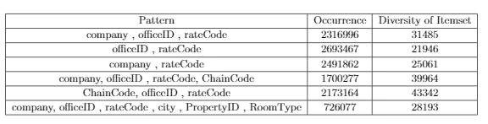
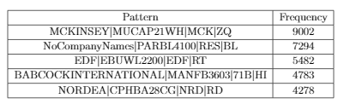
Inferring Business Policy
Introduction
Representative Context
Support
Literature
Review
Data
preprocessing
Confidence
Solution
Evaluation
Lift
Conclusion
Frequent itemset Mining
Association Rule Mining
Needs lots of memory
Apriori Algorithm
Notes:
definition of itemset which is a collection of zero or more items.
Support figures out how often a rule is frequent in a given data set, while confidence figures out how frequently items include Y appear in itemset that contains X.
Lift is a correlation measure which is used to extend the support and confidence for association rules.
In first step, I ran the apriori algorithm for the whole dataset with min support = 0.0008 and min confidence = 0.2 and min lift =3 for defined minimum length of 2, because we are searching to find at least the correlation between two parameters.
we found just 1382 rules which they were fit on our conditions.
In the Second step, I ran the algorithm for each company having more than 1000 different bookings, we tried to find the most correlated features based on the different companies. I chose the min-support of at least happening 100 times per all of the transaction of the company which is at least equal to 0.1. In general, we had 464 different companies which I chose min-lift of 1 for finding all of correlation.

Slide 13
Inferring Business Policy
Introduction
Representative Context
Literature
Review
city code
Data
preprocessing
Solution
company name
roomType
Known
Business
Policy
Evaluation
rate code
officeID
Conclusion
chain code
Suppliercode
Totalpricepernight
Notes:
definition of itemset which is a collection of zero or more items.
Support figures out how often a rule is frequent in a given data set, while confidence figures out how frequently items include Y appear in itemset that contains X.
Lift is a correlation measure which is used to extend the support and confidence for association rules.
In first step, I ran the apriori algorithm for the whole dataset with min support = 0.0008 and min confidence = 0.2 and min lift =3 for defined minimum length of 2, because we are searching to find at least the correlation between two parameters.
we found just 1382 rules which they were fit on our conditions.
In the Second step, I ran the algorithm for each company having more than 1000 different bookings, we tried to find the most correlated features based on the different companies. I chose the min-support of at least happening 100 times per all of the transaction of the company which is at least equal to 0.1. In general, we had 464 different companies which I chose min-lift of 1 for finding all of correlation.

Slide 14
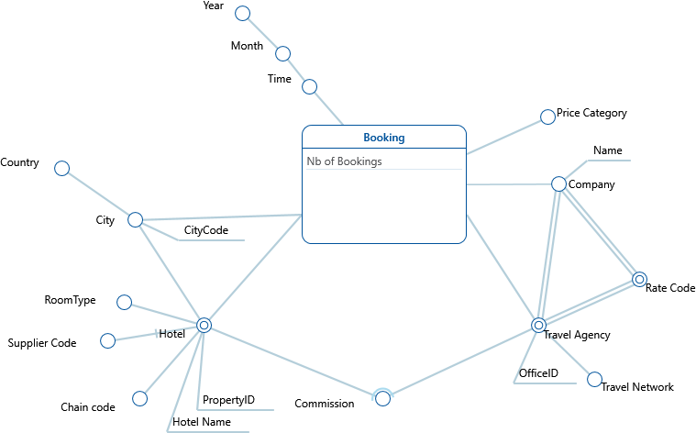
Integration OLAP with RS
Introduction
Multi Dimensional Model
Literature
Review
Data
preprocessing
Solution
Popularity
base RS
Similarity
Base RS
Matrix
Factorization
Evaluation
Conclusion
Notes:
definition of itemset which is a collection of zero or more items.
Support figures out how often a rule is frequent in a given data set, while confidence figures out how frequently items include Y appear in itemset that contains X.
Lift is a correlation measure which is used to extend the support and confidence for association rules.
In first step, I ran the apriori algorithm for the whole dataset with min support = 0.0008 and min confidence = 0.2 and min lift =3 for defined minimum length of 2, because we are searching to find at least the correlation between two parameters.
we found just 1382 rules which they were fit on our conditions.
In the Second step, I ran the algorithm for each company having more than 1000 different bookings, we tried to find the most correlated features based on the different companies. I chose the min-support of at least happening 100 times per all of the transaction of the company which is at least equal to 0.1. In general, we had 464 different companies which I chose min-lift of 1 for finding all of correlation.

Slide 15
Integration OLAP with RS
Introduction
Multi Dimensional Model
Literature
Review
Data
preprocessing
Solution
Popularity
base RS
Similarity
Base RS
Matrix
Factorization
Evaluation
Conclusion
Notes:
definition of itemset which is a collection of zero or more items.
Support figures out how often a rule is frequent in a given data set, while confidence figures out how frequently items include Y appear in itemset that contains X.
Lift is a correlation measure which is used to extend the support and confidence for association rules.
In first step, I ran the apriori algorithm for the whole dataset with min support = 0.0008 and min confidence = 0.2 and min lift =3 for defined minimum length of 2, because we are searching to find at least the correlation between two parameters.
we found just 1382 rules which they were fit on our conditions.
In the Second step, I ran the algorithm for each company having more than 1000 different bookings, we tried to find the most correlated features based on the different companies. I chose the min-support of at least happening 100 times per all of the transaction of the company which is at least equal to 0.1. In general, we had 464 different companies which I chose min-lift of 1 for finding all of correlation.

Slide 16
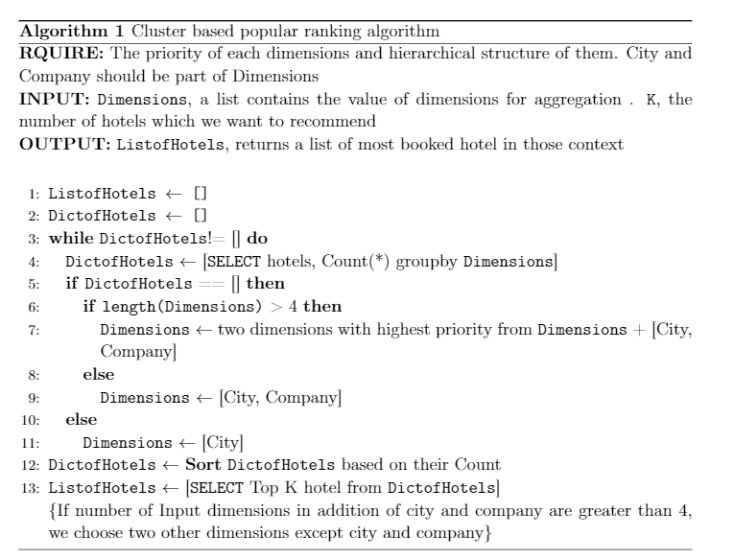
Integration OLAP with RS
Introduction
Multi Dimensional Model
Literature
Review
Data
preprocessing
Solution
Cluster based popular ranking method
Popularity
base RS
Similarity
Base RS
Matrix
Factorization
Evaluation
Conclusion
Notes:
definition of itemset which is a collection of zero or more items.
Support figures out how often a rule is frequent in a given data set, while confidence figures out how frequently items include Y appear in itemset that contains X.
Lift is a correlation measure which is used to extend the support and confidence for association rules.
In first step, I ran the apriori algorithm for the whole dataset with min support = 0.0008 and min confidence = 0.2 and min lift =3 for defined minimum length of 2, because we are searching to find at least the correlation between two parameters.
we found just 1382 rules which they were fit on our conditions.
In the Second step, I ran the algorithm for each company having more than 1000 different bookings, we tried to find the most correlated features based on the different companies. I chose the min-support of at least happening 100 times per all of the transaction of the company which is at least equal to 0.1. In general, we had 464 different companies which I chose min-lift of 1 for finding all of correlation.

Slide 17
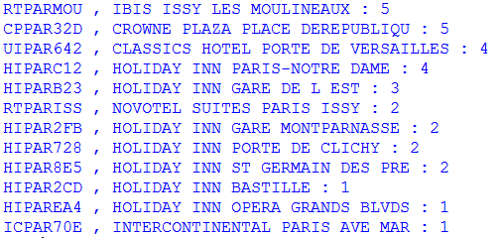
Integration OLAP with RS
Introduction
Cluster based popular ranking method
Literature
Review
Property IDs for Amadeus Company with AMA rate code in Paris
Data
preprocessing
Solution
Company
Amadeus
Popularity
base RS
Rate Code
Office ID
AMA
Similarity
Base RS
City Code
PAR
Room Type
Matrix
Factorization
© Amadeus IT Group and its affiliates and subsidiaries
Evaluation
Chain Code
Min price
Conclusion
Country Code
Max Price
Year
Month
Submit
Notes:
definition of itemset which is a collection of zero or more items.
Support figures out how often a rule is frequent in a given data set, while confidence figures out how frequently items include Y appear in itemset that contains X.
Lift is a correlation measure which is used to extend the support and confidence for association rules.
In first step, I ran the apriori algorithm for the whole dataset with min support = 0.0008 and min confidence = 0.2 and min lift =3 for defined minimum length of 2, because we are searching to find at least the correlation between two parameters.
we found just 1382 rules which they were fit on our conditions.
In the Second step, I ran the algorithm for each company having more than 1000 different bookings, we tried to find the most correlated features based on the different companies. I chose the min-support of at least happening 100 times per all of the transaction of the company which is at least equal to 0.1. In general, we had 464 different companies which I chose min-lift of 1 for finding all of correlation.

Slide 18
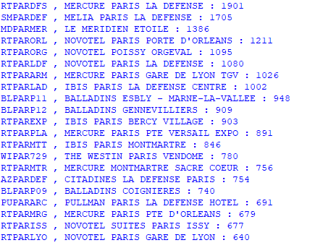
Integration OLAP with RS
Introduction
Cluster based popular ranking method
Literature
Review
Property IDs for new company ‘Samanu’ in Paris
Data
preprocessing
Solution
Company
Samanu
Popularity
base RS
Rate Code
Office ID
Similarity
Base RS
City Code
PAR
Room Type
Matrix
Factorization
© Amadeus IT Group and its affiliates and subsidiaries
Evaluation
Chain Code
Min price
Conclusion
Country Code
Max Price
Year
Month
Submit
Notes:
definition of itemset which is a collection of zero or more items.
Support figures out how often a rule is frequent in a given data set, while confidence figures out how frequently items include Y appear in itemset that contains X.
Lift is a correlation measure which is used to extend the support and confidence for association rules.
In first step, I ran the apriori algorithm for the whole dataset with min support = 0.0008 and min confidence = 0.2 and min lift =3 for defined minimum length of 2, because we are searching to find at least the correlation between two parameters.
we found just 1382 rules which they were fit on our conditions.
In the Second step, I ran the algorithm for each company having more than 1000 different bookings, we tried to find the most correlated features based on the different companies. I chose the min-support of at least happening 100 times per all of the transaction of the company which is at least equal to 0.1. In general, we had 464 different companies which I chose min-lift of 1 for finding all of correlation.

Slide 19
Integration OLAP with RS
Introduction
Multi Dimensional Model
Literature
Review
Data
preprocessing
Solution
Similarity based method
Popularity
base RS
a generalized grouping by on a coarse-grained level
Similarity
Base RS
Matrix
Factorization
Travel Network
City Code
 | Similarity | RMSE | MAE
SVD | Dot product | 0.0541 | 0.0178
SVD++ | Dot product | 0.0002 | 0.0001
KNN | Pearson | 0.0708 | 0.0291
KNN | Cosine | 0.0589 | 0.0203
LBE
Evaluation
1356
4106
Conclusion
OSL
Notes:
definition of itemset which is a collection of zero or more items.
Support figures out how often a rule is frequent in a given data set, while confidence figures out how frequently items include Y appear in itemset that contains X.
Lift is a correlation measure which is used to extend the support and confidence for association rules.
In first step, I ran the apriori algorithm for the whole dataset with min support = 0.0008 and min confidence = 0.2 and min lift =3 for defined minimum length of 2, because we are searching to find at least the correlation between two parameters.
we found just 1382 rules which they were fit on our conditions.
In the Second step, I ran the algorithm for each company having more than 1000 different bookings, we tried to find the most correlated features based on the different companies. I chose the min-support of at least happening 100 times per all of the transaction of the company which is at least equal to 0.1. In general, we had 464 different companies which I chose min-lift of 1 for finding all of correlation.

Slide 20
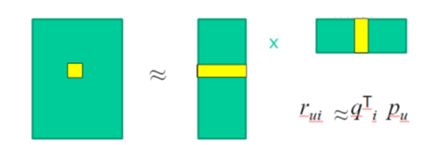
Matrix Factorization
Introduction
Literature
Review
R = Rating Matrix, m Companies, n Hotels;
P = User Matrix, m Companies, f latent factors/features;
Q = Item Matrix, n Hotels, f latent factors/features;
Data
preprocessing
Solution
R
P
Q
Popularity
base RS
n Hotels
f
n Hotels
Similarity
Base RS
f
Matrix
Factorization
m Companies
m Companies
Evaluation
r _{ui} = q _{i} ^{T} P _{u}
Conclusion
A rating rui can be estimated by dot product of user vector pu and
item vector qi
Notes:
Interactive Context :

Slide 21
Matrix Factorization
Introduction
R
P
Q
Literature
Review
n Hotels
f
n Hotels
f
Data
preprocessing
m Companies
m Companies
Solution
r _{ui} = q _{i} ^{T} P _{u}
Popularity
base RS
pu indicates how much user likes f latent factors;
Similarity
Base RS
qi means how much one item obtains f latent factors;
Matrix
Factorization
The dot product indicates how much user likes item;
Evaluation
The Latent Factor for companies could be “Company Size”, “Industry Type ”, “Revenue Category” and etc.
Conclusion
Notes:
Interactive Context :

Slide 22



Matrix Factorization
Introduction
Optimization
Literature
Review
Data
preprocessing
Solution
Popularity
base RS
Similarity
Base RS
Matrix
Factorization
Evaluation
Xui is the value from the dot product of two vectors
Conclusion
$$\min_{q,p}{\sum_{(u,i) ε R}{{\text{( }r_{\text{ui}}\text{ − }q_{i}^{T}p_{\text{u}}\text{)}}^{2}}\text{+ }\text{λ}{\text{(}\text{|}\text{q}\text{i}\text{|}\text{2 }\text{+ |}\text{p}\text{u}\text{|}\text{) }}^{2}}$$
regularization
Goodness to fit
Notes:
Optimization: to learn the values in P and Q
Goodness of fit: to reduce the prediction errors;
Regularization term: to alleviate the overfitting;
The function above is called cost function;

Slide 23

Matrix Factorization
Introduction
Literature
Review
Data
preprocessing
Fill in missing values
Solution
Dimension Reduction
Popularity
base RS
Similarity
Base RS
Inferring unknown features
(Unknown Business Policy)
Matrix
Factorization
Evaluation
Conclusion
Notes:
If we draw a landscape of loss function.
The x and y axes represent the values of the two weights. The z axis represents the value of the loss function for a particular value of two weights. Our goal is to find the particular value of weight for which the loss is minimum.
The first thing we do is to check, out of all possible directions in the x-y plane, moving along which direction brings about the steepest decline in the value of the loss function. This is the direction we have to move in. This direction is given by the direction exactly opposite to the direction of the gradient. The gradient, the higher dimensional cousin of derivative, gives us the direction with the steepest ascent.

Slide 24
Matrix Factorization
Introduction
f1
f2
f3
…
fk
Hotel 2
Hotel 3
Hotel n
Hotel 1
…
Literature
Review
Company 1
Company 1
2 |  |  | 10
 | 4 |  |  | 7
9 |  | 5
12 |  | 1 | 8
Company 2
Data
Analysis
Company 3
Company 2
…
Our Solution
Company 3
Company m
Evaluation
…
Conclusion
Company m
f1
f2
f3
…
fk
2 | 1 | 3 | 10 | 8
5 | 4 | 9 | 4 | 7
9 | 6 | 5 | 11 | 2
… | … | … | … | …
12 | 9 | 1 | 8 | 3
Hotel 1
Company 1
Hotel 2
Company 2
Hotel 3
Company 3
…
…
Hotel m
Post filtering
Company m
Optional Input
Notes:
If we draw a landscape of loss function.
The x and y axes represent the values of the two weights. The z axis represents the value of the loss function for a particular value of two weights. Our goal is to find the particular value of weight for which the loss is minimum.
The first thing we do is to check, out of all possible directions in the x-y plane, moving along which direction brings about the steepest decline in the value of the loss function. This is the direction we have to move in. This direction is given by the direction exactly opposite to the direction of the gradient. The gradient, the higher dimensional cousin of derivative, gives us the direction with the steepest ascent.

Slide 25
Model
Introduction
Implicit Data
Training Loss
Literature
Review
Post filtering
Required
Input
Hotel latent Features
Data
preprocessing
Solution
Company latent Features
Hotel representation
Popularity
base RS
Similarity
Base RS
Embedding
Hotel Profile
Company representation
Matrix
Factorization
Predicted
booking times
Predicted Ranks
Evaluation
Embedding
Optional Input
(Observable
Content)
Company Profile
Conclusion
27

Slide 26

Company Profile
Top 4 cities
Months of Travelling
Average price
Number of Bookings
Top 4 most
used rate codes
Average Length of
Stay
Number of visited cities
28
Notes:
https://pixabay.com/en/winning-motivation-succeed-man-1529402
Top 4 cities which are most popular traveling destination
4-top most used rate codes

Slide 27
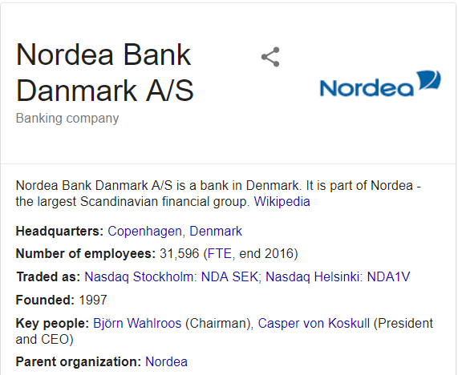

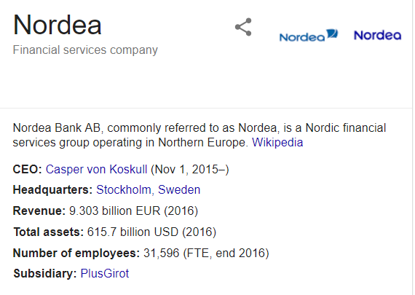
Stockholm
Helsinki
Oslo
Copenhagen
29

Slide 28




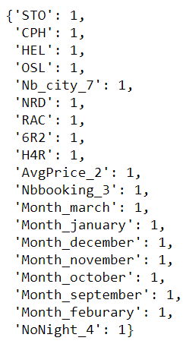

Nordea Profile
Average Price
Average length of stay
Months
Other features
Booking Times
Rate codes
Category 2:
8-27 Euro
Category 4:
16-25 nights
March
January
December
November
October
September
February
Category 3:
27-64
NRD
RAC
6R2
H4R
30

Slide 29

Hotel Profile
City of the hotel
Months of Travelling
Average price
Number of Bookings
Top 4 most
used rate codes
Average Length of
Stay
Supplier code
Average Lead Time
31
Average Commission Price
Notes:
https://pixabay.com/en/winning-motivation-succeed-man-1529402
Top 4 cities which are most popular traveling destination
4-top most used rate codes

Slide 30
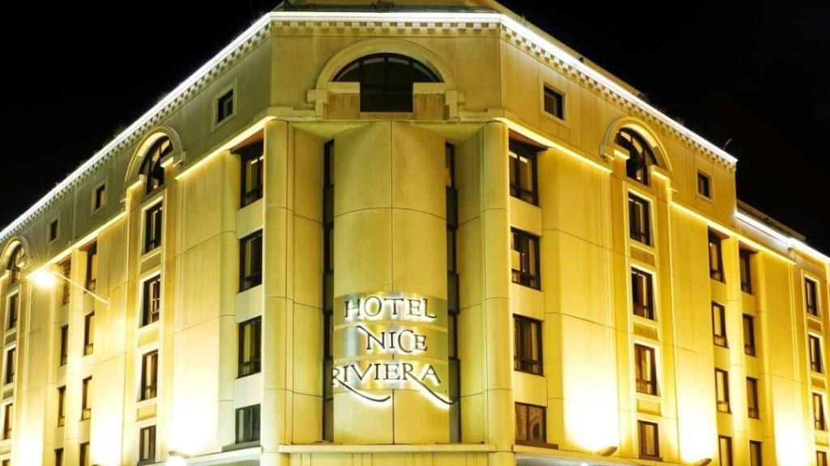
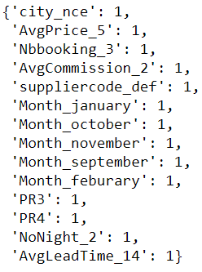
Hotel Nice Riviera Profile
City
Average
Price
Number
of Booking
Average
Commission
Supplier
Code
Months
Top 4
rate codes
Length
of Stay
Average
Lead Time
Nice
Category 5:
64 - 125
Category 3:
8 - 27
Category 2:
1 – 2
Default
January
October
November
September
February
PR3
PR4
Category 2:
1 - 4
14 days in
advance
32

Slide 31

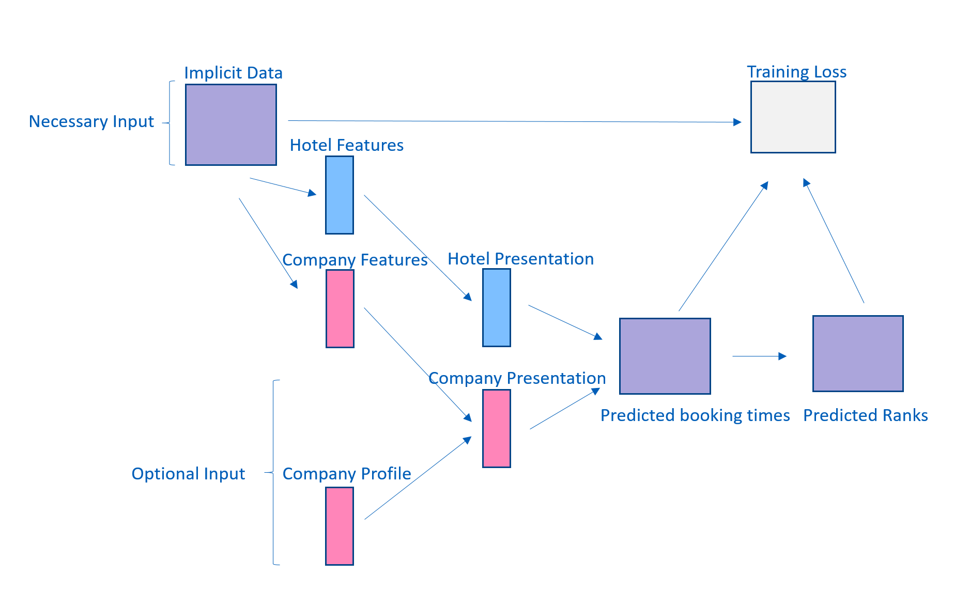
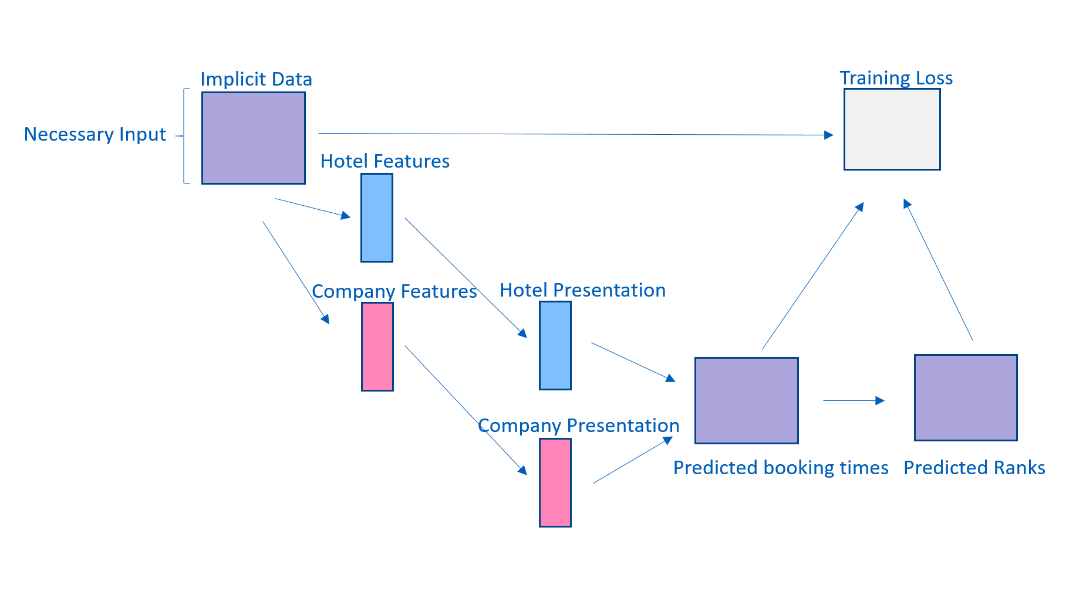
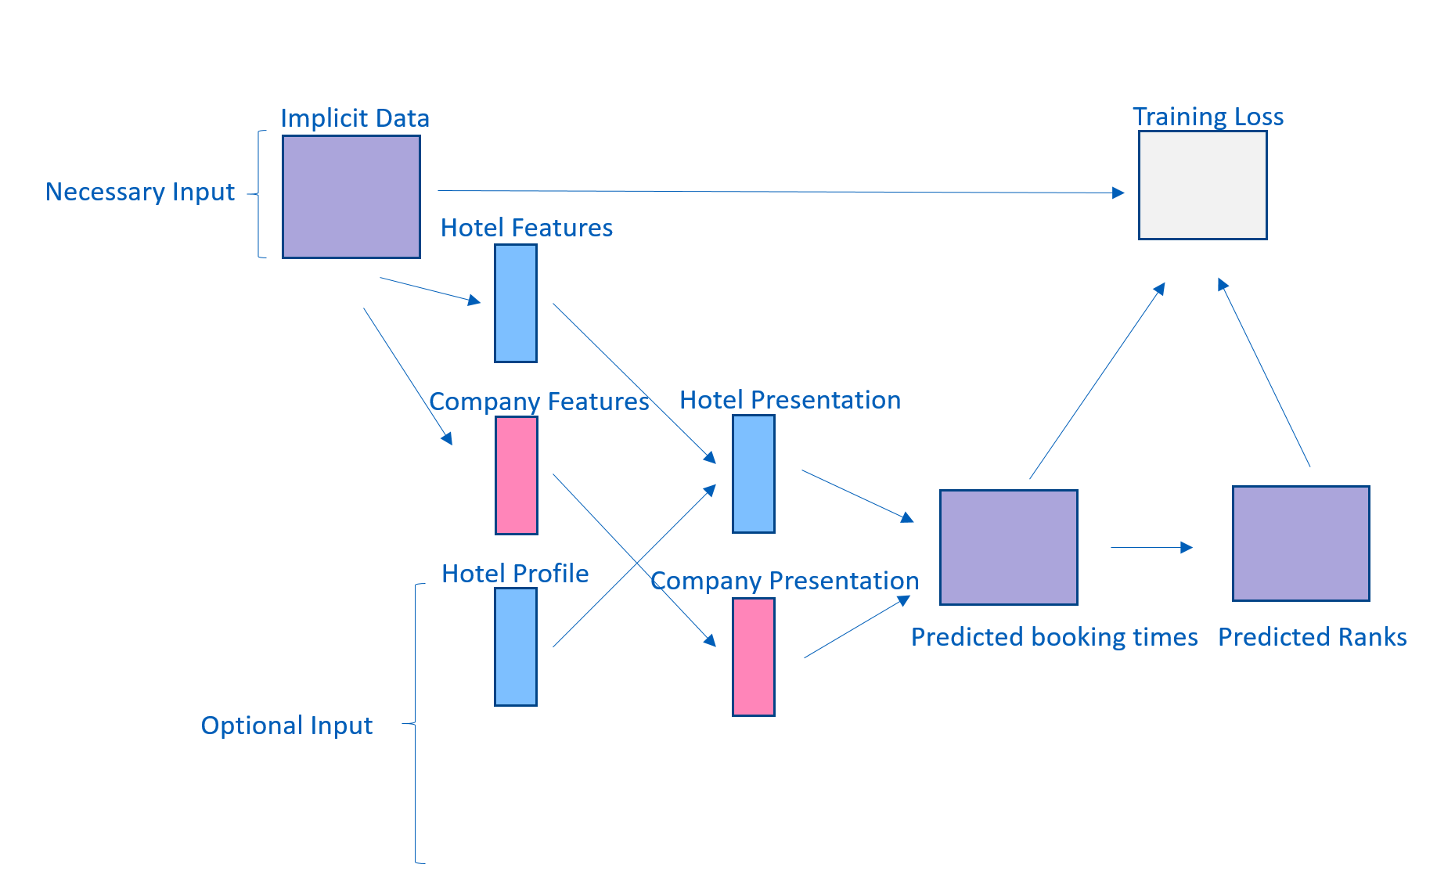
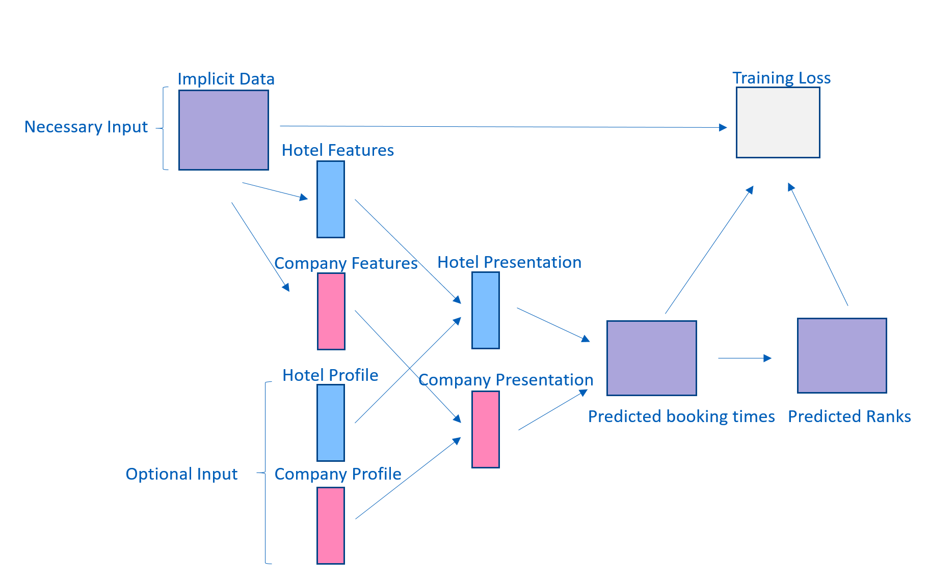
03
01
02
04
Embedding
Company Profile
Considering Implicit data combined with company profiles.
Matrix Factorization
Without Embedding
Considering Implicit data without considering side
information.
Embedding Hotel
Profile
Considering Implicit data combined just with hotel profiles.
Embedding both
Profiles
Considering Implicit data combined with both profiles.
Company and hotels
33

Slide 32
Learning Algorithms
Introduction
Literature
Review
Stochastic gradient descent (SGD)
Data
Analysis
Also known as incremental learning
For each given training case, the system predicts rui and computes the
associated prediction error
Our Solution
Evaluation
Alternating Least Squares (ALS)
Conclusion
Bayesian Personalized Ranking (BPR)
Weighted Approximate-Rank
Pairwise loss (WARP)
Adaptive Moment Estimation (Adam)
Notes:
If we draw a landscape of loss function.
The x and y axes represent the values of the two weights. The z axis represents the value of the loss function for a particular value of two weights. Our goal is to find the particular value of weight for which the loss is minimum.
The first thing we do is to check, out of all possible directions in the x-y plane, moving along which direction brings about the steepest decline in the value of the loss function. This is the direction we have to move in. This direction is given by the direction exactly opposite to the direction of the gradient. The gradient, the higher dimensional cousin of derivative, gives us the direction with the steepest ascent.

Slide 33
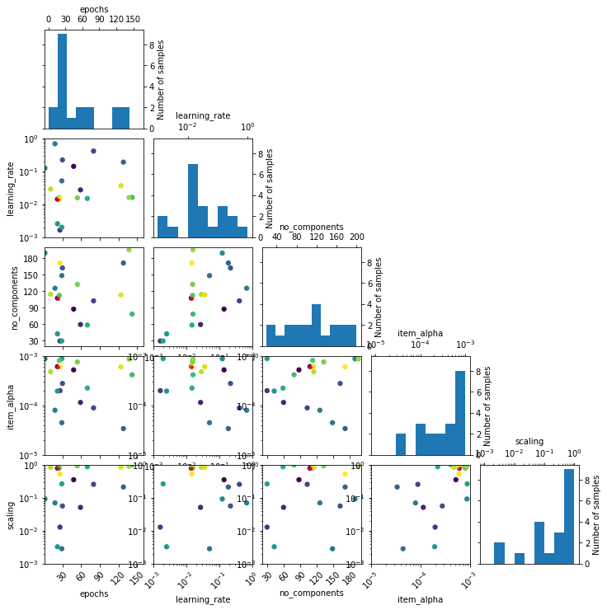
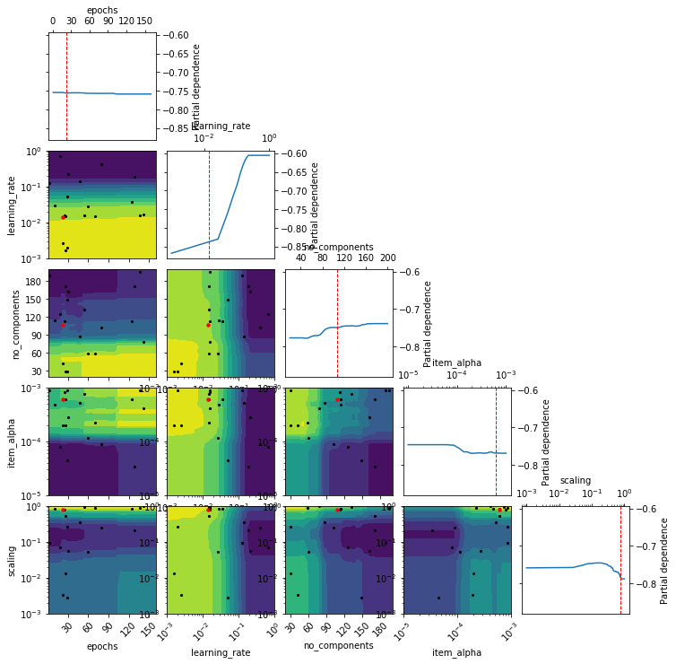
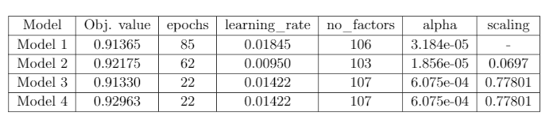
Hyperparameters
Introduction
Literature
Review
Data
Analysis
Our Solution
Evaluation
Conclusion
Notes:
If we draw a landscape of loss function.
The x and y axes represent the values of the two weights. The z axis represents the value of the loss function for a particular value of two weights. Our goal is to find the particular value of weight for which the loss is minimum.
The first thing we do is to check, out of all possible directions in the x-y plane, moving along which direction brings about the steepest decline in the value of the loss function. This is the direction we have to move in. This direction is given by the direction exactly opposite to the direction of the gradient. The gradient, the higher dimensional cousin of derivative, gives us the direction with the steepest ascent.

Slide 34
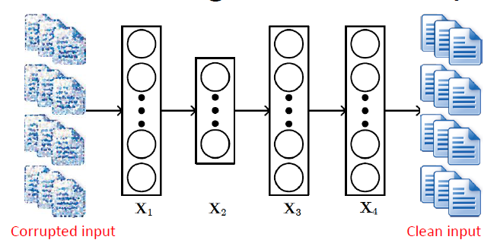
Collaborative Deep Learning
Introduction
Literature
Review
Data
Analysis
Our Solution
Evaluation
Conclusion
Stacked Denoising Autoencoders
Yang, 2018
Notes:
It is a hierarchical Bayesian model, which performs deep representation learning for the content information and collaborative filtering for the utility matrix. CDL is using stacked denoising autoencoder (SDAE) for its feature learning component which is explained in section

Slide 35
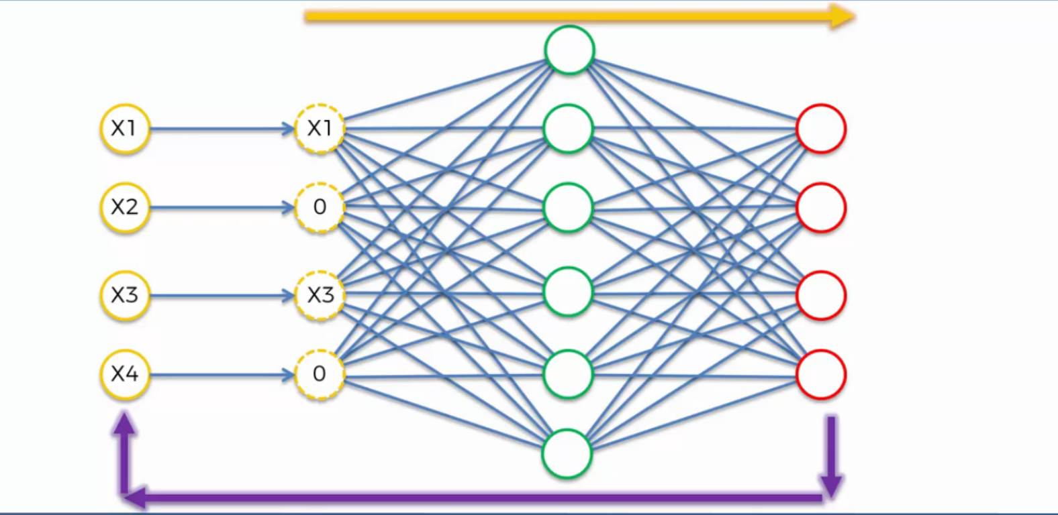
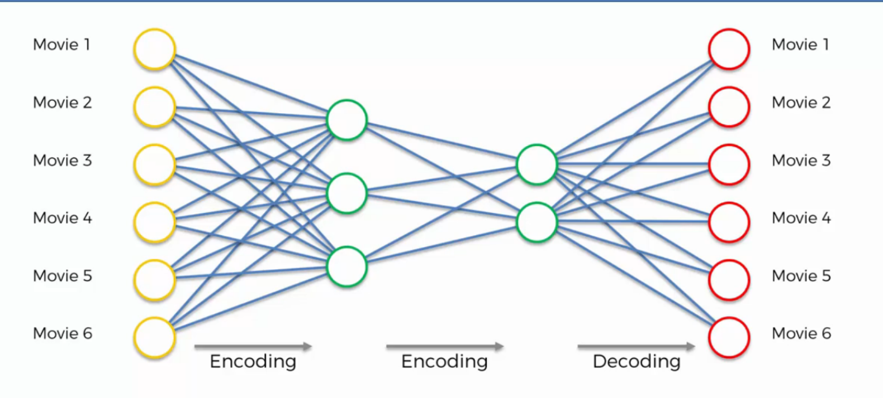
Stacked Denoising Autoencoders
Introduction
Literature
Review
Data
Analysis
Our Solution
Evaluation
Conclusion
Hotel 1
Hotel 1
Hotel 2
Hotel 2
Hotel 3
Hotel 3
Hotel 4
Hotel 4
Hotel 5
Hotel 5
Hotel 6
Hotel 6
Notes:
SDAE is a feedforward neural network for learning representations of the data by learning to predict clean input itself in the output. Usually in a neural network, the hidden layer in the middle is constrained to be a bottleneck and the input layer is a corrupted version of the clean input. An SDAE solves the following problem:
a specific instance of supervised learningwhere the targets are generated from the input data.
Randomly turn some of the units of the first hidden layers to zero. This is a stochastic AutoEncoder.
Stack many (sparse) auto-encoders in succession and train them using greedy layer-wise learning
Drop the decode layer each time
Supervised training on the last layer using final features
Then supervised training on the entire network to fine- tune all weights
Performs better than stacking RBMs for unsupervised pre-training.
Empirically not quite as accurate as DBNs.

Slide 36
ALS
BPR
WARP
Adam
Popularity
WRMF
LightFM
LightFM
CDL
Pointwise
Pairwise
Pairwise
Pairwise
Personalized popularity ranking per each user
Model_WRMF
Model_1_BPR
Model_2_BPR
Model_3_BPR
Model_4_BPR
Model_1_WARP
Model_2_WARP
Model_3_WARP
Model_4_WARP
PMF_OpenRec
UserPMF_OpenRec
1
4
4
2
1
38
Notes:
Weighted Regularized
Matrix Factorization (WRMF)

Slide 37
Introduction
Literature
Review
Data
preprocessing
Solution
Evaluation
Conclusion

Slide 38
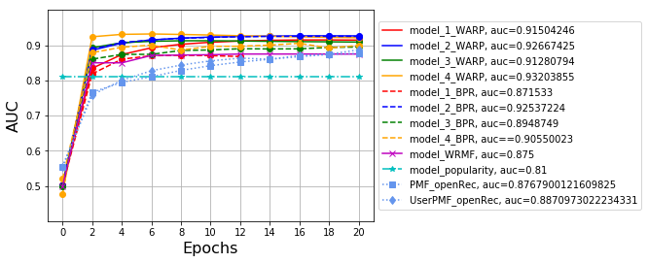
Evaluation
Introduction
Literature
Review
Data
preprocessing
Solution
Evaluation
Conclusion

Slide 39
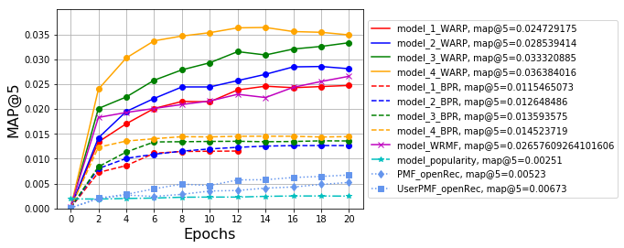
Evaluation
Introduction
Literature
Review
Data
preprocessing
Solution
Evaluation
Conclusion

Slide 40
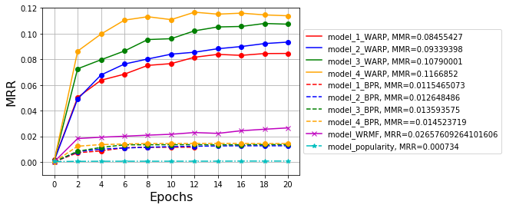
Evaluation
Introduction
Literature
Review
Data
preprocessing
Solution
Evaluation
Conclusion

Slide 41
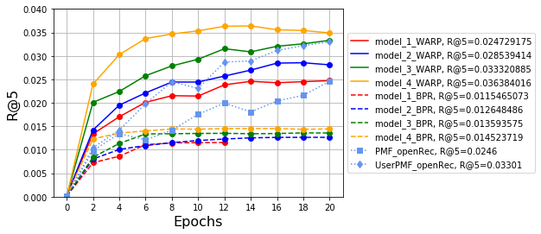
Evaluation
Introduction
Literature
Review
Data
preprocessing
Solution
Evaluation
Conclusion

Slide 42
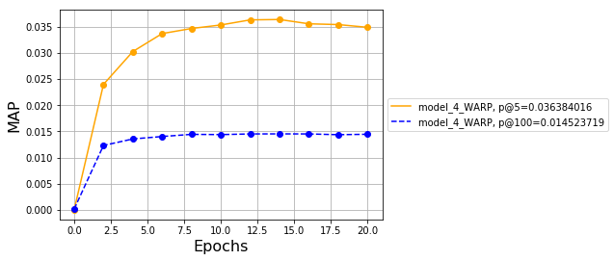
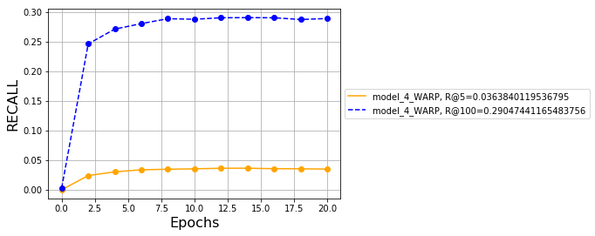
Evaluation
Introduction
Literature
Review
Data
preprocessing
Solution
Evaluation
Conclusion

Slide 43
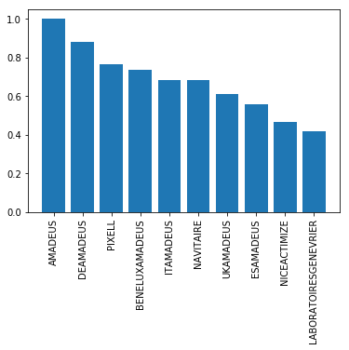
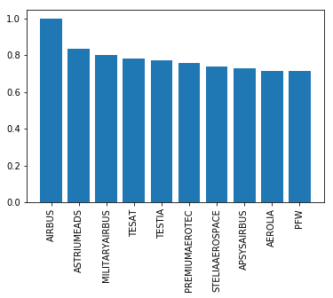
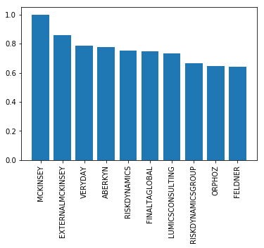
Evaluation
Introduction
Literature
Review
Data
preprocessing
Solution
Evaluation
Conclusion

Slide 44
Post-filtering
Introduction
Literature
Review
OfficeID
Sponsorship
Data
preprocessing
r
r
r
r
Solution
…
City
Month
Evaluation
Conclusion
f
w
c
b
y
Obligatory
This dimension is
obligatory for our
model
Separated RS
If we want different result for recommendations per each office ID, we can first filter based on the officeID and give more priority to the hotels were was booked already with the officeID.
Time
More accurate result based on the
expected availability
of the hotels in
different months
Priority
Giving Priority to the hotels which they are sponsors
…
Any other kind of
information can be
Considered for post-filtering

Slide 45



Conclusion
Introduction
Literature
Review
Data
preprocessing
1
Model_4_WARP
(Matrix Factorization)
Solution
2
Company and Hotel profiles are easy to modify & they can improve the performance
Evaluation
3
Conclusion
Model-based RS
4
add in side information without blowing up the computational speed
Python 3.6
16 GB RAM
Corei7
Notes:
Also, we can use the external information as profile like sentimental analysis and etc.

Slide 46
Future Work
Introduction
Literature
Review
Data
preprocessing
1
Different Neural network model for
same model
Solution
2
Experiment CDL method with all of raw data of companies and hotels
Evaluation
3
Conclusion
Factorization learning methods just with a few contexts
4
Adding sentiment or visual information as the input to our model
Notes:
Also, we can use the external information as profile like sentimental analysis and etc.

Slide 47




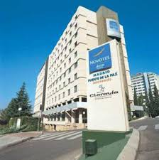










Model 1
Model 2
Model 3
Model 4
Madrid
Amadeus

Slide 48


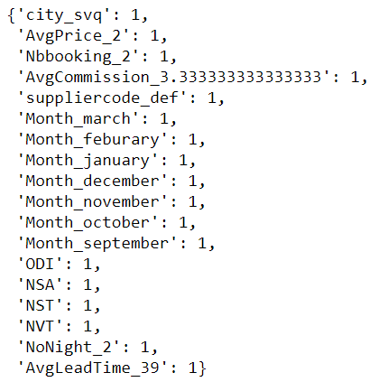
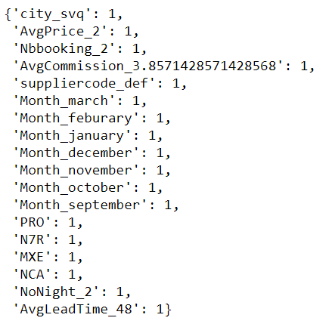

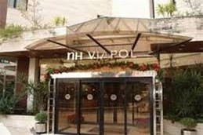
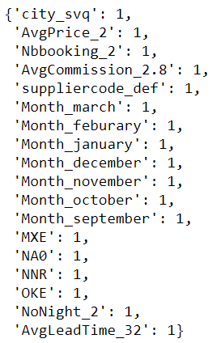
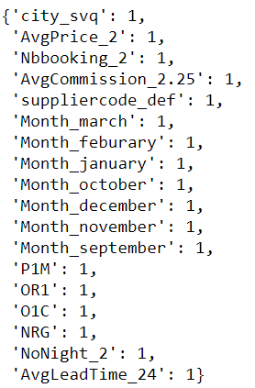
NH SEVILLA PLAZA DE ARMAS
MELIA LEBREROS
1
3
Recommended Hotel
Recommended Hotel
MELIA SEVILA
NH COLLECTION SEVILLA
2
4
Recommended Hotel
Recommended Hotel
AMADEUS
SVQ

Slide 49
Methodology
Hotel Recommender System for Anonymous Business Travellers
Context
Post Filtering
Post filtering by
Inspiration from OLAP
Experiments &
Evaluation
LightFM
WRMF
…
CDL
Best Model
Different Models
Matrix Factorization
Method
Creating
User and Item Profiles
User Profiles
User Latent
Factors
Item Latent
Factors
Utility Matrix
Item Profiles
Data Analysis and
Interpretation
Known
Business Policies
Frequent
Itemset Mining
Association
Rules Mining
Data Gathering and Cleaning
Extracting name of
Company
Handling Duplicates
Transforming Data
…
Handling
Missing Values

Slide 50



Contribution
Creating a model based
Hotel recommendation system
Creating user and item
profiles just based on
Implicit feedback
Integration of OLAP
architecture with RS for
considering context

Slide 51

Thank you
Any question?

